Slide 1


Simple Code-writing Problems that GenAI cannot solve
(at present)
Introductory Programming (CS1) level
AI code-generation tools that are easy for students to access:
ChatGPT
GitHub Copilot
Viraj Kumar
Kotak-IISc AI-ML Centre
ACM India Council

Slide 2
Why are such problems interesting? (1/2)
Code-writing remains a key learning outcome
  ACM/IEEE-CS CS2023 (Software Development Fundamentals):
14 LO’s (Develop := design, write, test and debug)
1. Develop programs that use the fundamental programming constructs:…
2. Develop programs using functions…
3. Develop programs that effectively use the different structured data types…
4. Develop programs that use file I/O…
5. Develop programs that use language-provided libraries and frameworks (where applicable).
6. Develop programs that use APIs to access or update data (e.g., from the web).
7. Develop programs that create simple classes and instantiate objects of those classes…
9. Develop recursive functions.
10. Develop programs that can handle runtime errors.

Slide 3
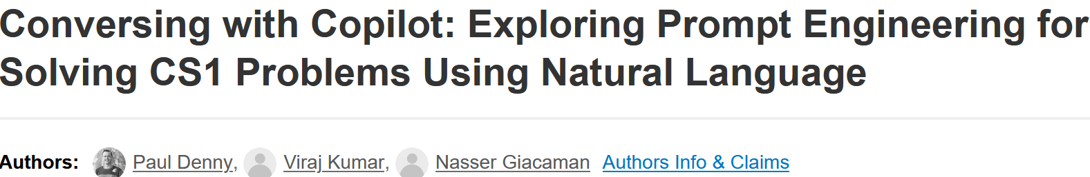
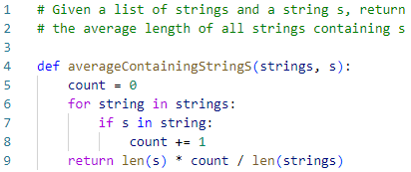
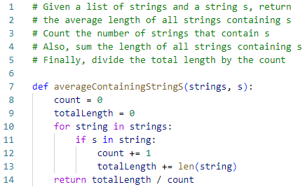
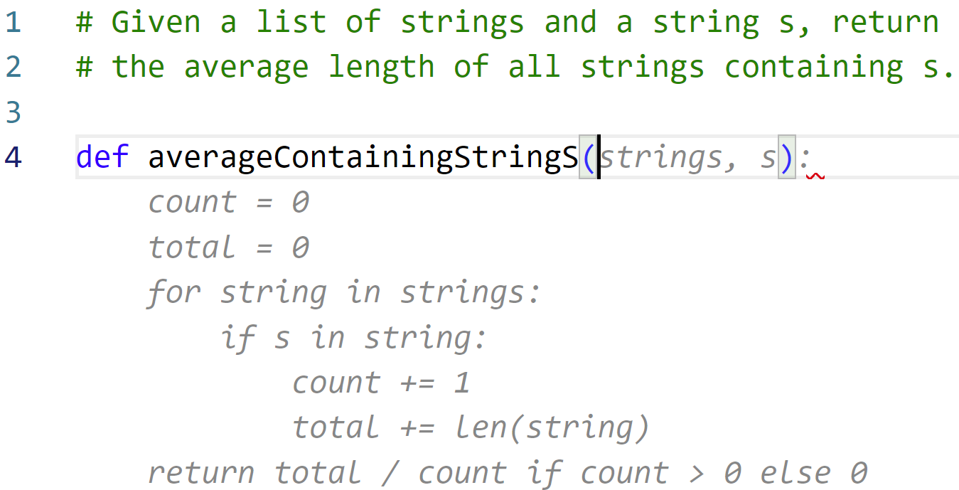


Why are such problems interesting? (2/2)
GenAI tools can solve simple code-writing problems (1/2)
DOI: 10.1145/3545945.3569823
GitHub Copilot
(July, 2022)
Algorithmic thinking
GitHub Copilot
(March, 2024)
Copy + paste
50%
80%
166 CodeCheck problems (Python)
[Horstmann, SPLICE’21]

Slide 4
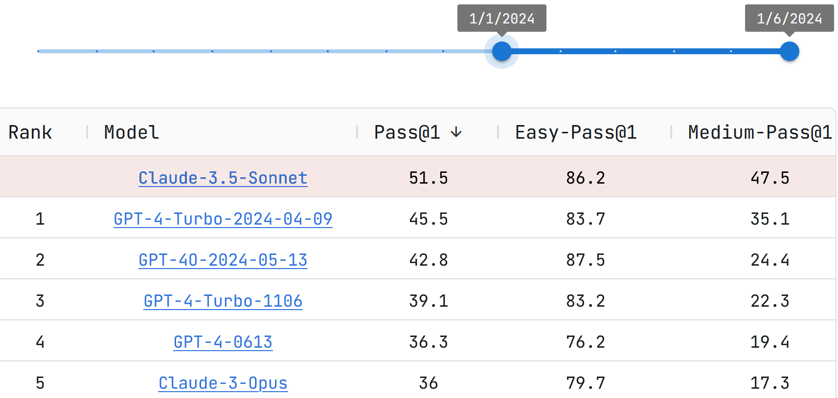
Why are such problems interesting? (2/2)
GenAI tools can solve simple code-writing problems (2/2)
https://livecodebench.github.io/leaderboard.html
These tools are easy for students to access
So, motivating students to develop code-writing skills via unproctored programming assignments may no longer be possible

Slide 5
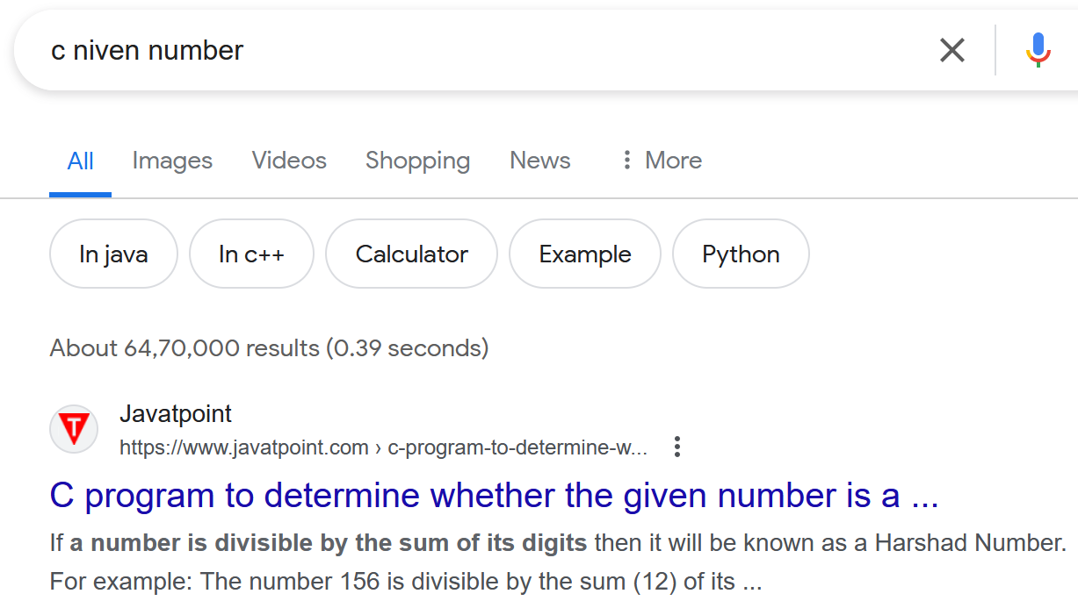
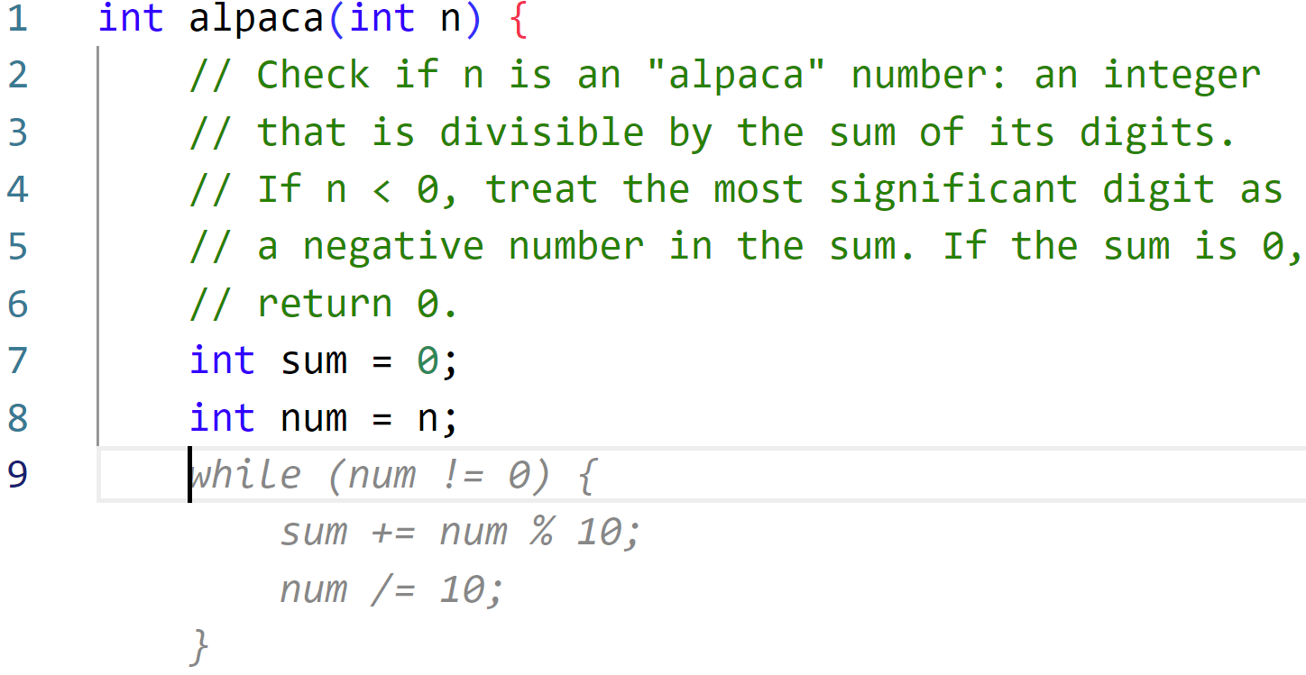
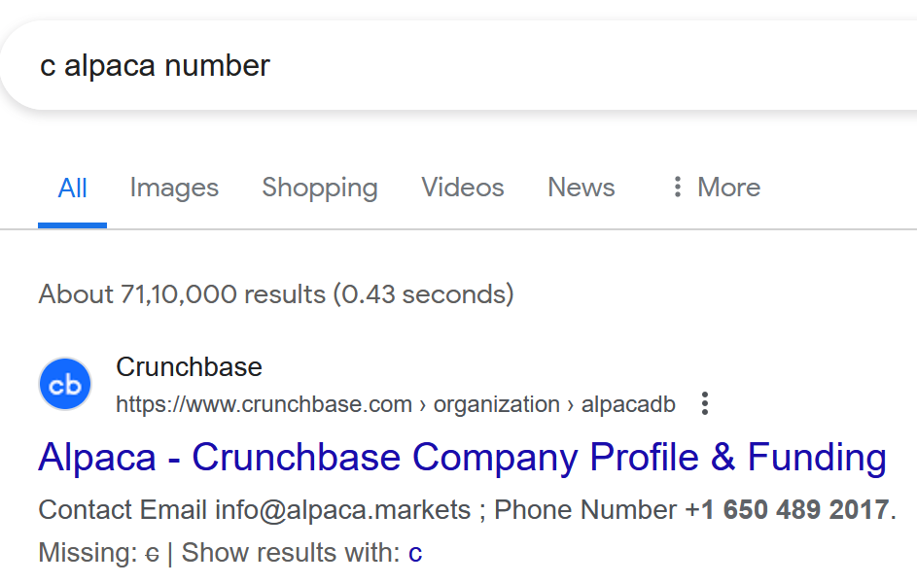
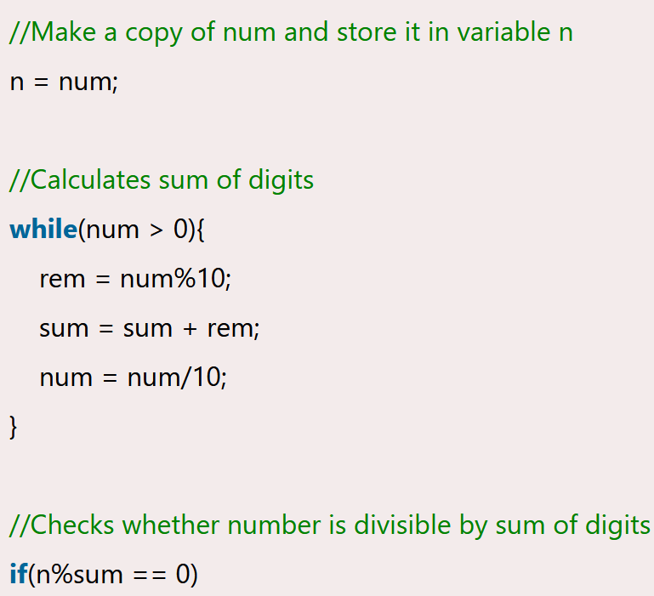
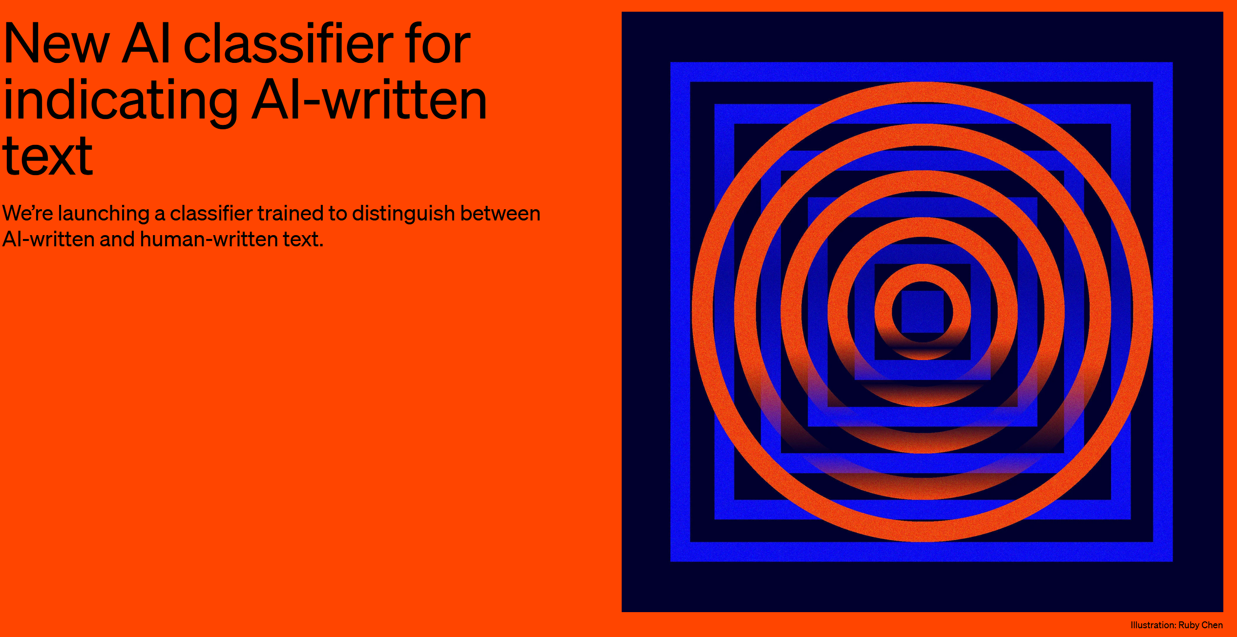
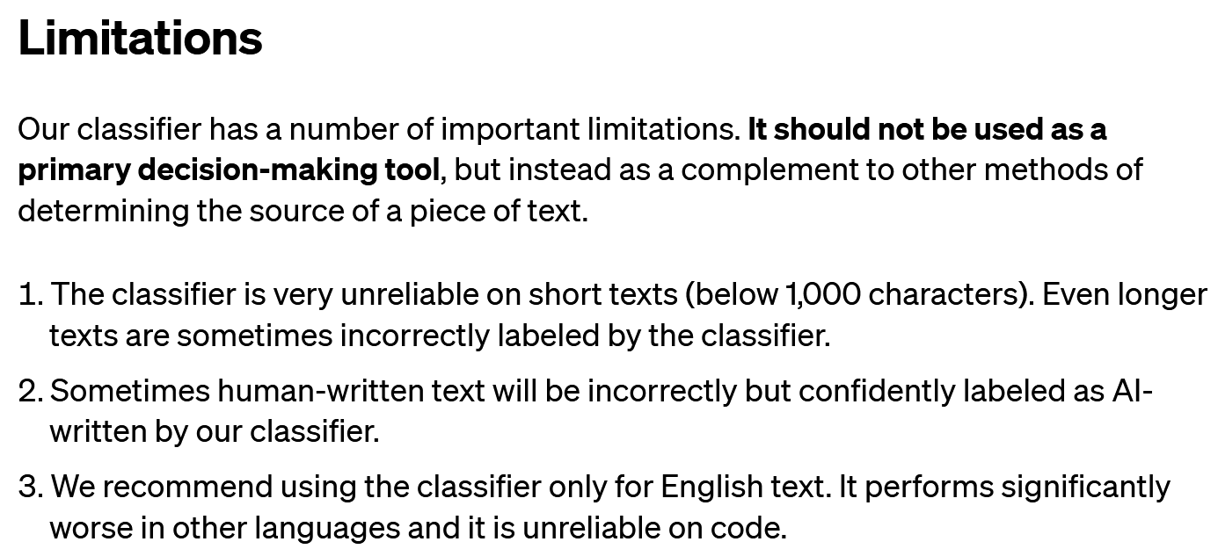
But wait…
Isn’t this the same as the “copy from the internet” problem?
Can’t tools detect AI-generated code?
January 2023 to June 2023

Slide 6
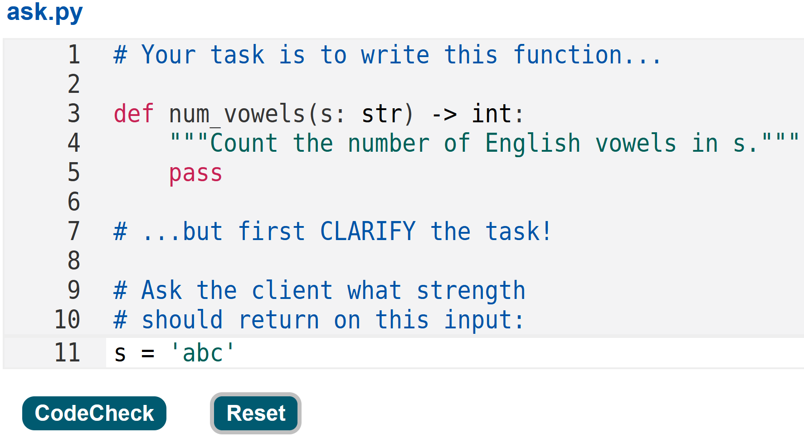
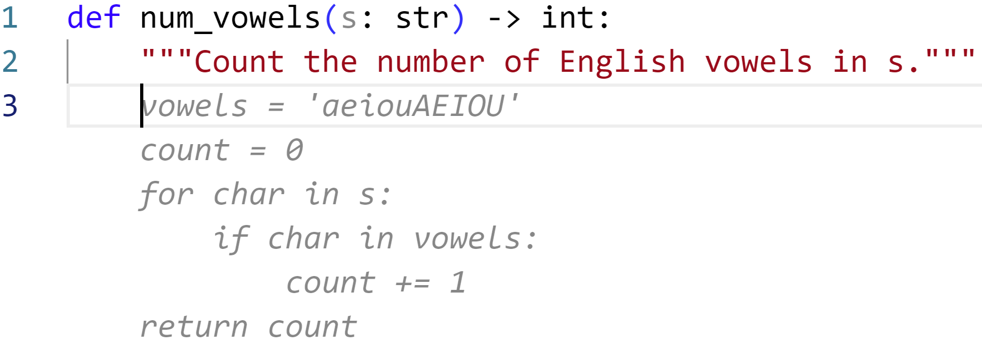
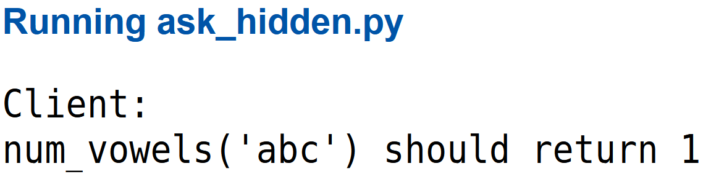
Our Proposal
Probeable Problems
  (arXiv: 2405.15123)
  Simple code-writing problems with key details missing:
    Count the number of distinct English vowels in a given string,
    ignoring the differences between uppercase and lowercase vowels.
  A mechanism to ask “the client” clarifying questions and confirm answers
Ask
Confirm

Slide 7
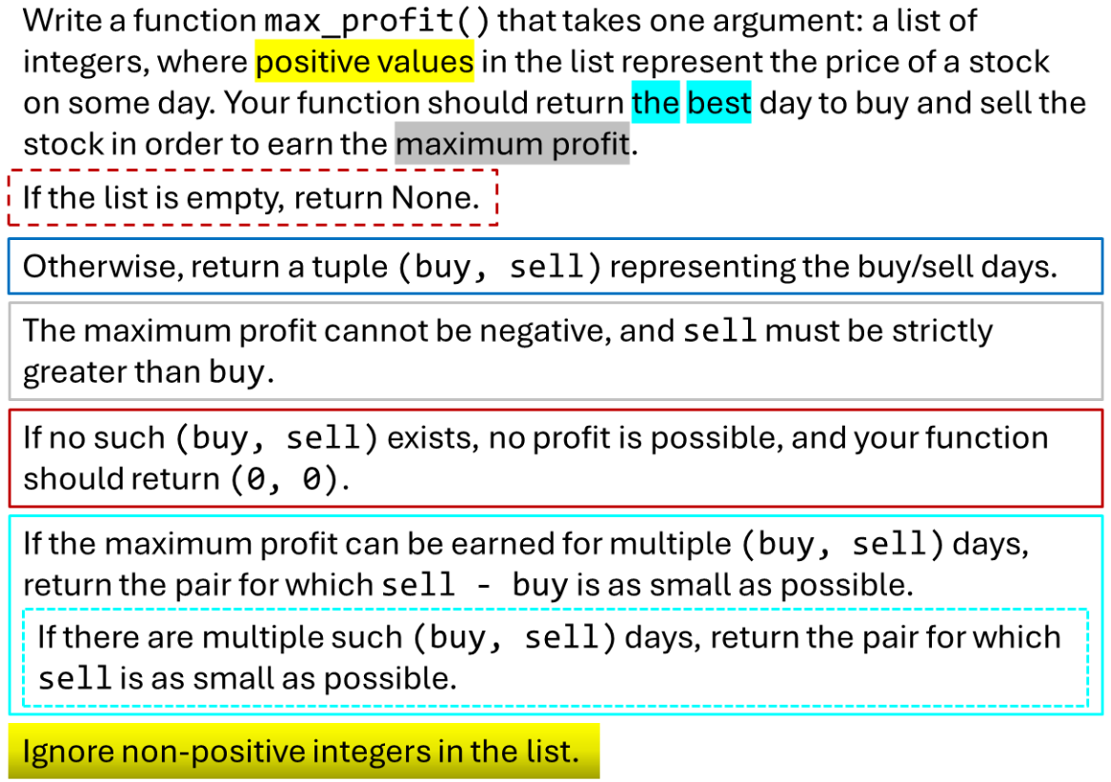
Creating Probeable Problems
Start with a detailed specification, then delete details
  Which ones?
Suggested categories of details
  Definitions
  Behaviour on certain inputs
    Chiaroscuro
  Return type(s)
  Tie-break mechanism(s)

Slide 8
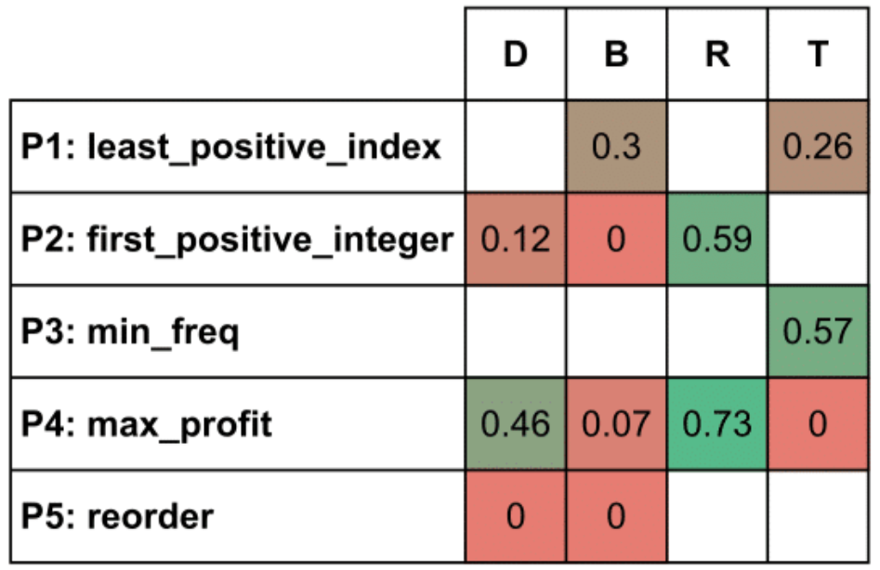
“GenAI-proof” Problems
90-minute Competitive Programming-with-AI contest
  ACM India Student Chapters
  67 students, 26 teams
  5 problems
On average, contestants found just 20% of all missing details

Slide 9
Implementation plans at IISc (August 2024)
Probeable Problems for all in-lab code-writing exercises
Students are given only the Confirm links; they work in teams
TAs are given the Ask links (they are the Clients)
Student teams get credit for approaching Clients and asking clarifying questions
  Refinement: Only allow “good” clarifying questions

Slide 10
Summary
Probeable Problems (a.k.a. Ask the Client problems) appear to be “GenAI-proof”, at least for now
  GuardRails: Automated Suggestions for Clarifying Ambiguous Purpose Statements. (COMPUTE’23, DOI: 10.1145/3627217.3627234)
They may help our students develop a valuable ability: Asking (good) clarifying questions
  Client-blind junior developer roles → None || more client-facing
Try one in C:
  Confirm
  Ask

